Slide 1
State and Local Income Tax Refunds and Other Recoveries
Pub 4012 – Tab D
Pub 4491 – Lesson 9
Notes:
Tax refunds and recoveries occur regularly
All counselors should have good working knowledge of the no-benefit rule
Practice using either the TaxSlayer or Bogart calculators is encouraged
The comprehensive topic at the end is for Unused Non-refundable Credits (another way that there was no benefit)

Slide 2
Lesson Topics
Tax benefit rule
State income tax refund
Determining taxable portion
Sales tax calculation
Comprehensive topic
Prior year unused non-refundable credits

Slide 3
Definition of Recovery
Tax Benefit Rule
In a prior year, you
Paid an expense and
Deducted the expense and
Your taxes were reduced and
In current year
You received a refund or reimbursement of the expense then
The refund or reimbursement received is taxable in the current year
Up to the amount of the deduction that reduced taxes in the prior year
Notes:
This is called the tax benefit rule

Slide 4
Recovery Examples
Most common occurrence is state or local tax refund
Other recoveries
Shown on Schedule C, E, or F if previously deducted on that schedule (rare)
Other taxable recoveries would be shown as Other Income on the return (rare)
Notes:
This lesson is for state income tax recoveries only
Instructor asks learners for examples of other recoveries: medical reimbursements for expenses that were deducted on schedule C;

Slide 5
State Income Tax Refund
Where do you look for state refund?
Intake Booklet
Form 1099-G – State or local income tax refund
Last year’s returns
State for overpayment
Federal: itemized state income tax?
Notes:
Instructors ask learners, How do you know if taxpayer received state refund?
State does not always mail 1099-G
Encourage counselors to ask probing questions

Slide 6
State Refund
If taxpayer received a state refund last year, does it count as income in the current year?
Answer: It depends
Notes:
Instructor goes to next slide for quiz

Slide 7
Quiz: Is State Refund Taxable?
Taxpayer used standard deduction last year
Taxpayer itemized last year
Taxpayer does not have Form 1099-G
Taxpayer itemized last year
Used Sales Tax deduction
Used Income Tax deduction
No
Maybe
Maybe
No
Maybe
Notes:
Counselors must be aware to look for last year’s state refund, and know when they need to figure whether it is taxable this year. Explanations are below
Because they did not itemize, taxpayer did not get a Federal tax credit for state taxes they paid. No benefit; therefore, not taxable.
Because they did itemize, taxpayer might have gotten a tax credit for state taxes they paid. Depends on whether taxpayer used Sales Tax or Income Tax deduction.
Not all states issue tax form Form 1099G. Look at last year’s state tax return to determine if taxpayer received a state tax refund.
Taxpayer’s credit was based on state sales tax paid. Their state refund is irrelevant, because taxpayer did not take a deduction for state income taxes. No benefit; therefore, not taxable.
Counselor must use worksheet in TSO to determine. Example to follow.

Slide 8
State Tax Refund: No Tax Benefit
Determine if in prior year
The standard deduction was used
Sales tax was deducted
Taxable income plus refund is less than zero
Yes to any – refund is not taxable

Slide 9
State Tax Refund: No Tax Benefit
No tax benefit
Do not enter the refund in TaxSlayer
Note “not taxable” and reason in Intake Booklet

Slide 10
State Tax Refund: Tax Benefit
Prior year tax return information required if tax benefit
Only immediately preceding year’s refund in scope except
If taxpayer agrees 100% taxable
If taxpayer claimed standard deduction for all years (0% taxable)
If taxpayer claimed sales tax deduction for all years (0% taxable)
Notes:
Emphasize the calculation is complex and out of scope when:
If taxpayer received a refund from a year prior, for example to 2017
Example of why:
Filed 2017 (standard deduction) and paid balance due in 2018
Filed 2018, itemized and claimed state income tax deduction (including balance due on 2017)
Filed amended 2017 and got state income tax refunded, received in 2019
Would need to test 2018 return for the taxable amount of the refund based on 2017 return – too complex

Slide 11
Calculation Worksheets
Pub 4012 Tab D
Options to determine taxable amount of refund
TaxSlayer State and Local Refund Worksheet
Pub 4012, Tab D
Bogart Refund Calculator
COTAXAIDE.ORG/TOOLS

Slide 12
Income Tax Versus Sales Tax
Look at preceding year’s Schedule A Line 5
Taxable amount never more than income tax deduction claimed minus the sales tax deduction that could have been claimed

Slide 13
Calculate Preceding Year’s Sales Tax
Pub 4012 Tab F
Begin with AGI from Form 1040
Add income not taxed (e.g. non-taxable SS, SSI, VA benefits)
Use General Sales Tax Deduction Income Worksheet in NTTC-modified Pub 4012 Tab F
Use sales tax deduction calculator at irs.gov to determine state and local sales tax for preceding year
Input in state refund worksheet
Notes:
Go to IRS.gov, search sales tax calculator, which will compute sales tax per the tables for a number of prior years

Slide 14
State Tax Refund Worksheets
Most common error:
Forgot to input sales tax that could have been deducted
New for 2019
State tax deduction may have been capped
More likely refund is not taxable
Remember limitation when using worksheet or Bogart calculator
Notes:
Emphasize
Can go to IRS.gov, search sales tax calculator, which will compute sales tax per the table for a number of prior years
Can use instructions for Schedule A and pick sales tax from the table

Slide 15
Practice 1
State income tax refund from 2018: $500
2018 return shows:
Single
Total itemized deduction $14,000
AGI = $25,000; Taxable income $11,000
State income tax $1,500
Property tax $1,000
Home mortgage interest $11,500
Notes:
Instructor asks learners: Is state refund taxable? Answer: Maybe. Must use TSO worksheet.
Instructor should have learners go to IRS.gov Sales Tax Calculator to calculate sales tax for taxpayer, using AGI $25,000 and NC zip code 28145

Slide 16
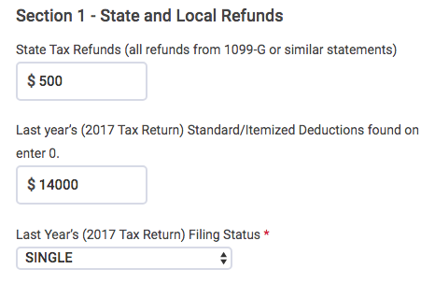
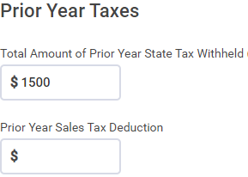
Practice 1 TaxSlayer Entry
Calculated on irs.gov using 2018 Sales Tax Deduction Calculator NC zip code 28145
588
$500 state refund is fully taxable.
Notes:
Instructor asks learners, What’s missing?
For TSO to calculate correct taxable amount, all data must be entered
Most common error: not entering sales tax deduction that could have been taken

Slide 17
Practice 2
State income tax refund from 2018: $750
2018 return shows:
Single
Total itemized deducts $15,000
State income tax $7,000
Property tax $5,000
Total state tax deduction (SALT) capped at $10,000
Home mortgage interest $5,000
Notes:
Instructor asks learners: Is $500 state refund taxable? Answer: Next slide
Total Itemized Deductions = $10,000 (capped) + $5,000 = $15,000

Slide 18
Practice 2 Result
None of the $750 state refund is taxable
Why?
The taxpayer is over the SALT limit by $1,250
$6,250 (state income tax liability) + $5,000 (property tax)
$11,250 = $10,000 (SALT cap) + $1,250 (unclaimed benefit)
Therefore, taxpayer did not receive benefit from $750
Notes:
Taxpayer paid $7,000 in state taxes; actual state tax liability was $6,250 ($750 was refunded)
If there was no SALT limit, the taxpayer would have gotten tax benefit from the $750 refund. As it stands, the taxpayer did not get a deduction for $750 in state taxes; therefore the $750 refund is not taxable

Slide 19
Example of Other Recovery (Rare)
Taxpayer paid hospital bills in preceding year and deducted them on Schedule A
Insurance reimbursed those expenses in current year
Taxable amount of reimbursement (amount which created a prior year tax benefit) is reported as other income

Slide 20
Quality Review
Confirm state income tax refund was only for preceding year or one of the exceptions applies
Review prior year’s return
Itemized
Income tax deducted
Negative taxable income
Any unused credits (see Comprehensive Topic later)
Notes:
All counselors should be aware to look for unused non-refundable credits if there is a refund or recovery
Can refer to more experienced counselor

Slide 21
Comprehensive Topic
Unused Non-refundable Credits

Slide 22
Unused Tax Credits in 2018
Confirm if there were unused tax credits – look at preceding year’s tax return
Was tax after non-refundable credits zero?
If so, potential unused credits
Note: TaxSlayer limits a credit before putting on Form 1040 – look at details of the credits for full credit amount
Open the prior year return if prepared at your site
Will be easier to calculate taxable refund – see instructions in Bogart Refund Calculator
Notes:
Note: TaxSlayer limits credits on Line 55 to total tax due on Line 47 so a zero on Line 55 does not mean every possible non-refundable credit was used, only enough to offset tax due.

Slide 23
Unused Tax Credits in Preceding Year
Taxable amount of recovery is limited to
Refund amount
- less-
Amount of additional income that does not result in a lower tax because unused credits now apply (this is the no-benefit portion)
Use the Bogart refund calculator
Notes:
Note: TaxSlayer limits credits on Line 55 to total tax due on Line 47 so a zero on Line 55 does not mean every possible non-refundable credit was used, only enough to offset tax due.

Slide 24
Practice 3
State income tax refund from 2018: $500
2018 return shows:
Single with dependent boyfriend incapable of self-care due to car accident
SE income $25,000; AGI $25,000; Taxable Income $10,900
Total itemized deducts $14,100
State income tax $1,600 (all paid through withholding)
Property tax $1,000
Home mortgage interest $11,500
Total Form 1040 line 12 credits 1,121 (Form 2441 total credit $900; used $900 plus CTC/credit for other dependents on L 12a $221)
Notes:
Instructor: Is the $500 refund taxable? Let’s use Bogart to find out.

Slide 25
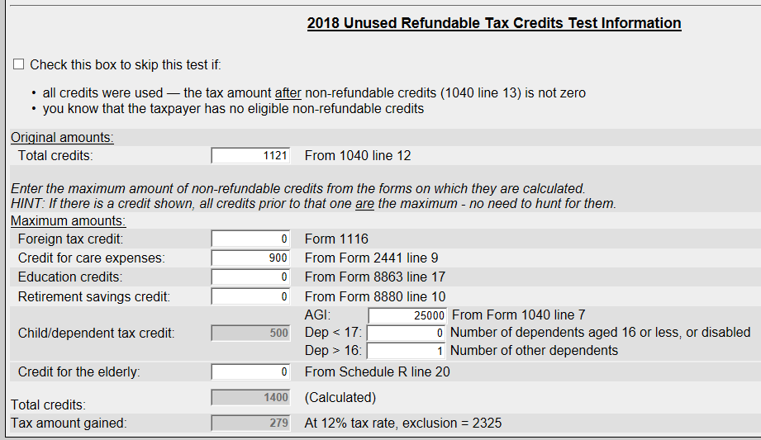
Practice 3 – Bogart Calculator Results
$500 Refund not taxable:
Refund less than excludible amount of $2,325
Notes:
Exclusion amount is the amount of additional income the taxpayer could have had in 2018 to use full amount of all non-refundable credits

Slide 26
State And Local Income Tax Refunds
Questions?
Comments…

